Slide 1
Site Selection for Nodes & Hubs (Electric Charging)
Along Delhi – Agra Highway Stretch

Slide 2
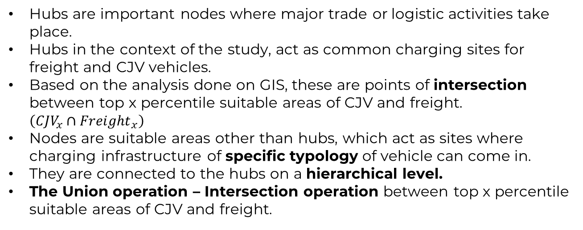
Difference between nodes and hubs in highway?
Hubs are important nodes where major trade or logistic activities take place.
Hubs in the context of the study, act as common charging sites for freight and CJV vehicles.
Based on the analysis done on GIS, these are points of intersection between top x percentile suitable areas of CJV and freight. $\left({CJV}_{x}∩{Freight}_{x}\right)$
Nodes are suitable areas other than hubs, which act as sites where charging infrastructure of specific typology of vehicle can come in.
They are connected to the hubs on a hierarchical level.
The Union operation – Intersection operation between top x percentile suitable areas of CJV and freight.
Node
Hub
Node
Node
x – 10%ile / 15%ile / 20%ile

Slide 3
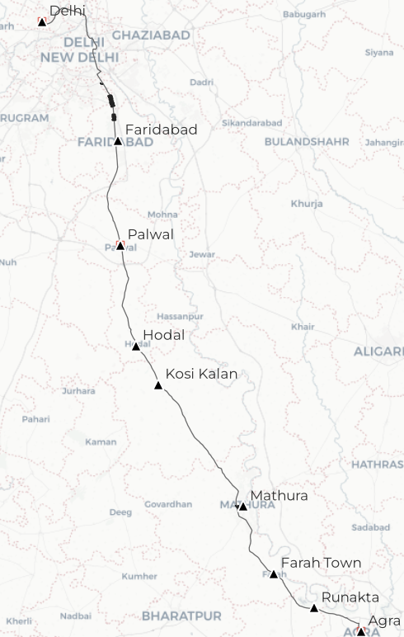
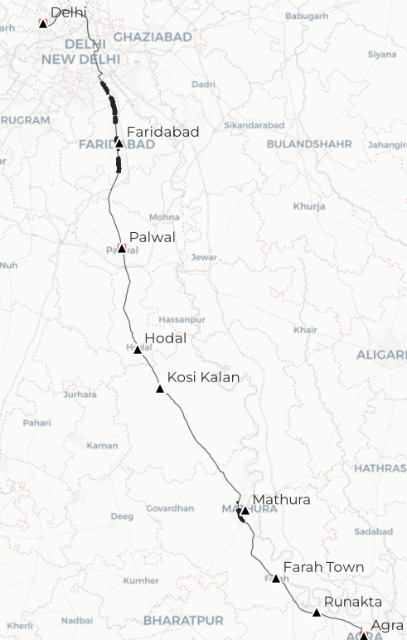
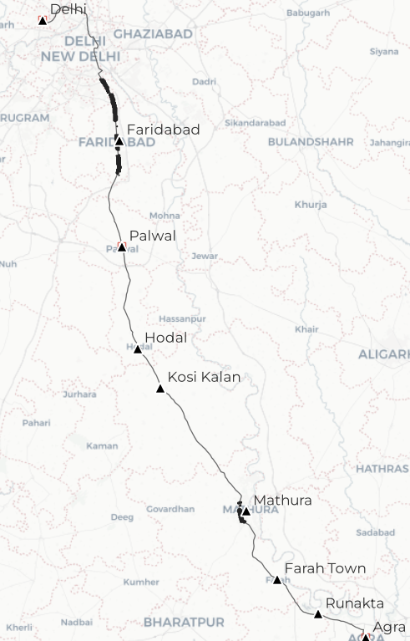
10, 15, 20 percentile of CJV
Badarpur &
Faridabad Border
Top 10 Percentile
Top 15 Percentile
Top 20 Percentile
Not to scale

Slide 4

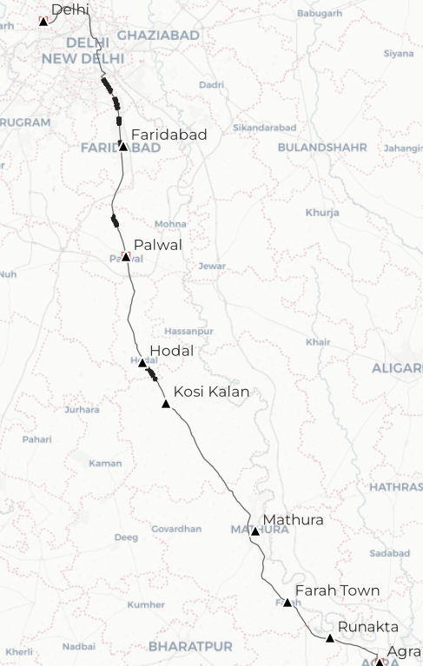
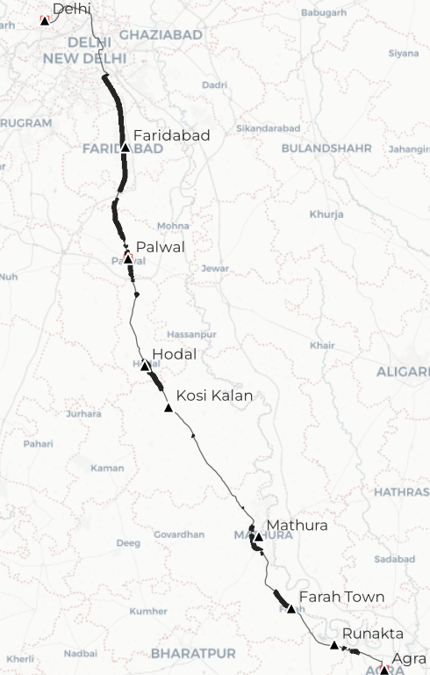
10, 15, 20 percentile of Freight
Badarpur &
Faridabad Border
Delhi NCR
Section
From Okhla
To Palwal
Near Palwal
Top 10 Percentile
Top 15 Percentile
Top 20 Percentile
Not to scale

Slide 5
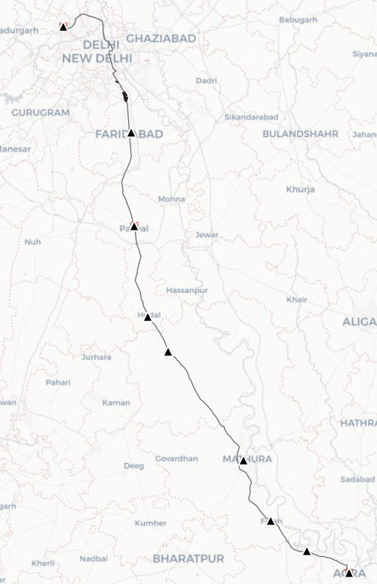
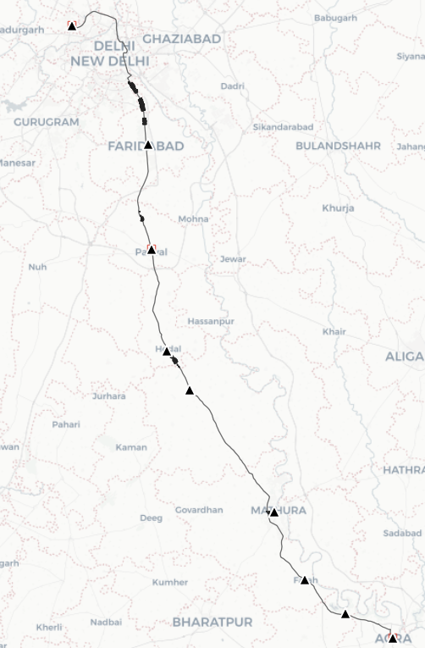
Scenario #1 top 10 percentile between CJV and Freight top 10%ile Suitability
Intersection operation
Union operation
Badarpur Power Station
Okhla
South of Badarpur Border
(Faridabad)
North of Palwal
Hodal
The location is also crucial as it is situated on the Delhi Haryana Border, hence the traffic concentration is high.
These are ideal areas for common charging spots.
Mathura
The areas identified along the outskirts are Freight specific Nodes.
Not to scale
Not to scale

Slide 6
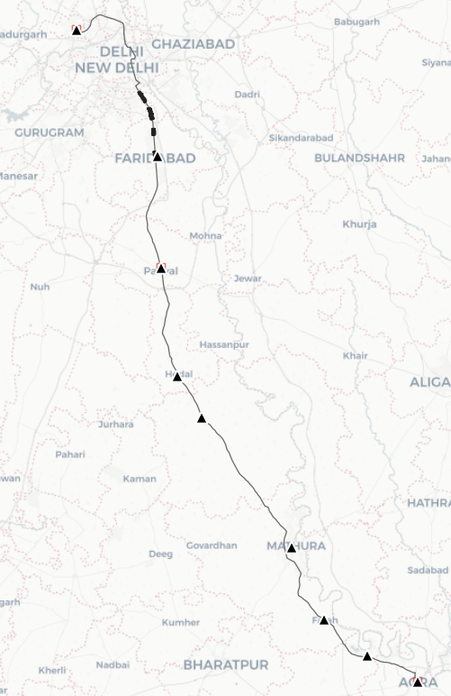
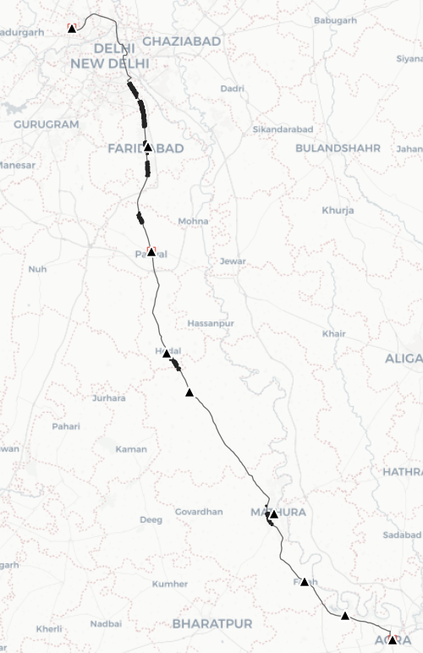
Scenario #2 top 15 percentile between CJV and Freight top 15%ile Suitability
Intersection operation
Union operation
Okhla
Faridabad Railway Station
Badarpur Border
Ballabgarh
North of Palwal
Under 15%ile suitability, area within the Faridabad city may by an ideal candidate Hub point, specifically along the metro and railway corridor of Faridabad and south of Badarpur Border.
Hodal
Mathura
Not to scale
Not to scale

Slide 7
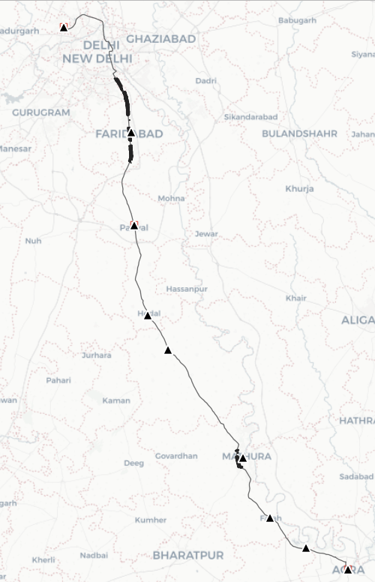
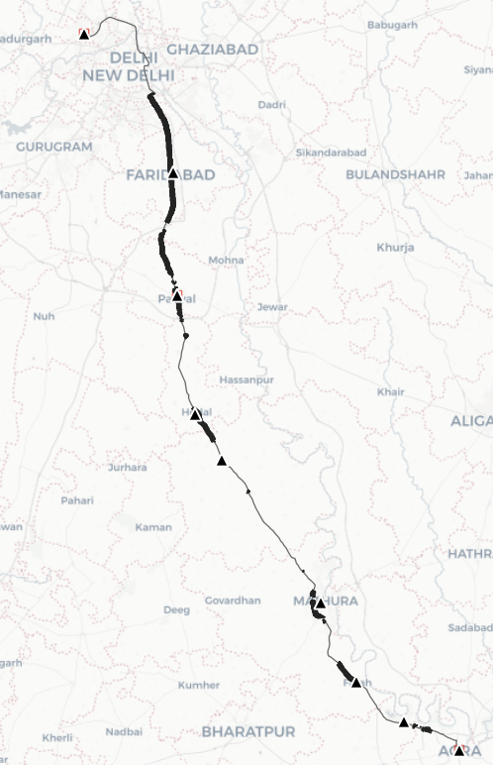
Scenario #3 top 20 percentile between CJV and Freight top 20%ile Suitability
Intersection operation
Union operation
The section to the south of Ballabgarh up to Agra (except NH44 section in Mathura) are ideal node location specific to Freight.
Okhla to Badarpur Section
Faridabad – Ballabgarh
Stretch
Delhi NCR section till Palwal
Hodal
Mathura
Mathura
Even in this level, there is no scope of hubs between Mathura and Faridabad.
Farah
Agra
Not to scale
Not to scale

Slide 8
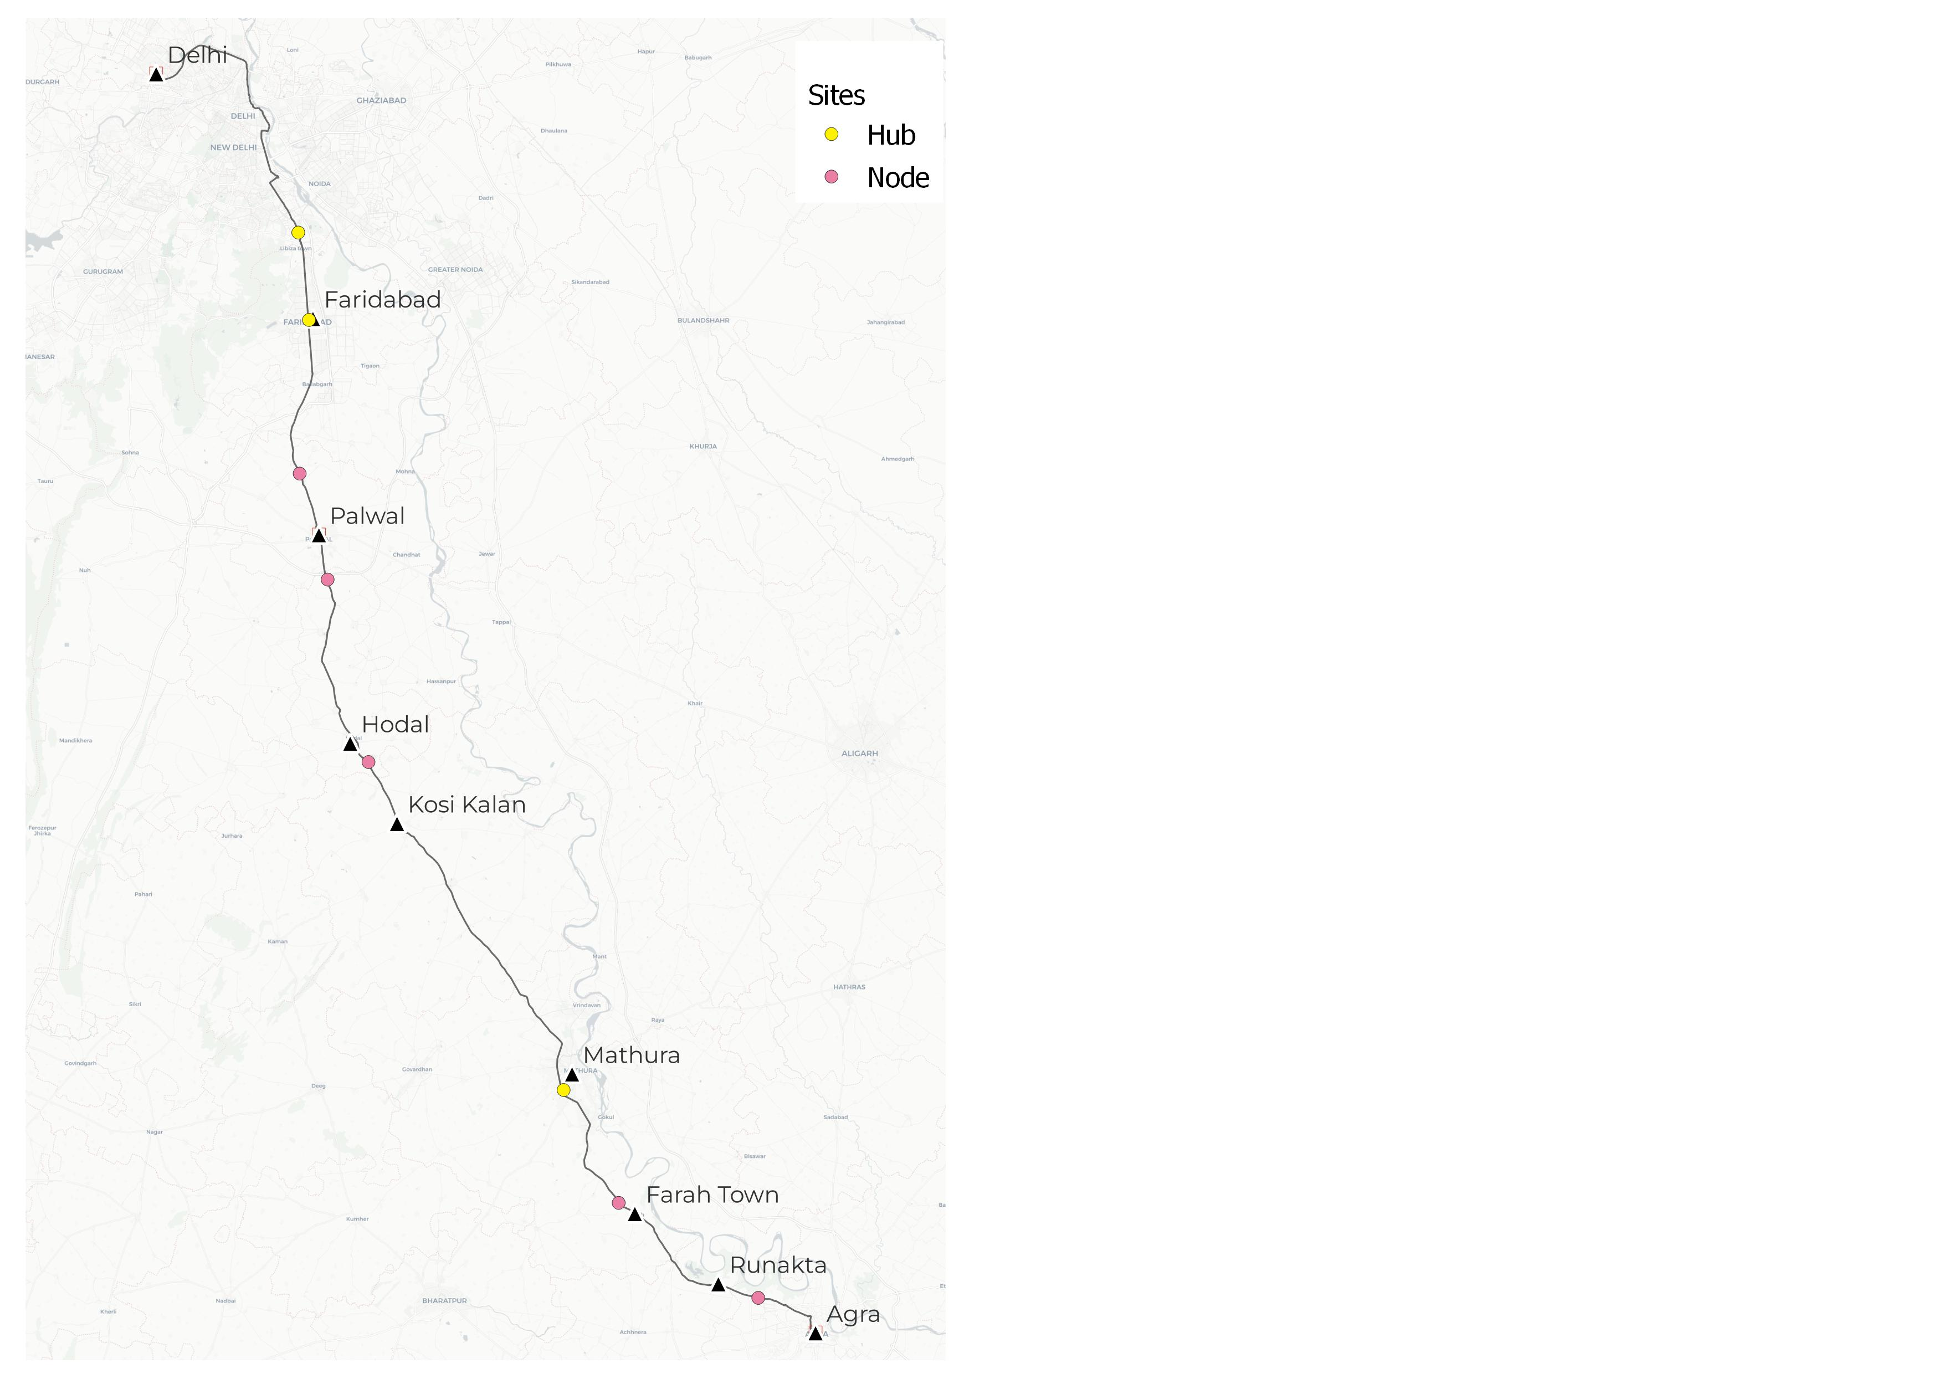
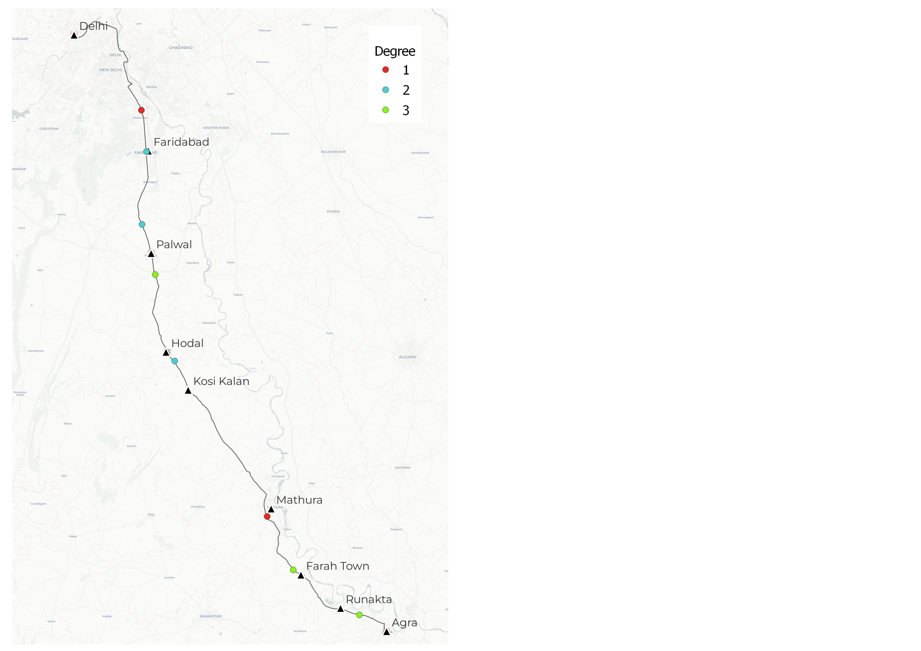
Inference – optimum sites for nodes and hubs
Based on all three situations
Nodes & Hubs
Degree
Degree 1 sites are selected with respect to intersection tool on all the three percentile cases. Mathura and Badarpur hubs are Degree 1 site.
The only hub that comes under Degree 2 is in Faridabad. This is because there is another hub within proximity, a trade-off to economical gains.
Sites identified as hubs in top 20th percentile are in degree 3.
Badarpur
Faridabad
Based on Intersection tool, the three hubs are selected.
Nodes are selected based on Union tools.
Nodes are specific to Freight.
Mathura
Not to scale
Not to scale

Slide 9
Weights of 4 Criteria
BWM, AHP & Fuzzy AHP
Inference
From this Table, Criteria 3 is most important and Criteria 4 is least important.

Slide 10
Ranks of all Sites for 9 Methods (3 Sites for CJV)
Based on all four Criteria
For Freight
For CJV
Based on the Ranking, Site 2 which acts as Hub, is the most popular site amongst 8 sites, using 9 MCDM Methods.

